Slide 1
DIGIT RECOGNITION USING CONVOLUTIONAL NEURAL NETWORKS(CNN)
Done by:
Supraja G D,
192225024,
AI& ML.

Slide 2

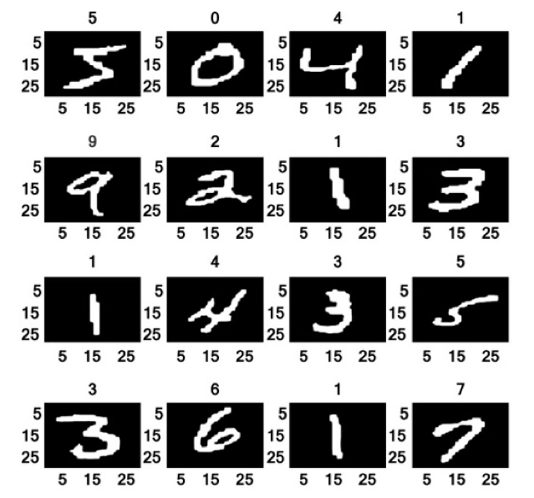
Introduction to Digit Recognition
Digit recognition is the ability of machines to accurately identify and classify handwritten or printed numeric digits. It is a crucial component of many applications, such as document processing, banking, and security systems.

Slide 3
Overview of Convolutional Neural Networks
Layers
Image Recognition
Efficiency
Convolutional neural networks (CNNs) are a type of deep learning model that uses a series of convolutional, pooling, and fully connected layers to extract and learn features from input data.
CNNs excel at image recognition tasks, making them well-suited for digit recognition applications. They can learn to identify patterns and features in the input data.
CNNs are efficient and effective, often outperforming traditional machine learning algorithms for image-based tasks, such as handwritten digit recognition.

Slide 4
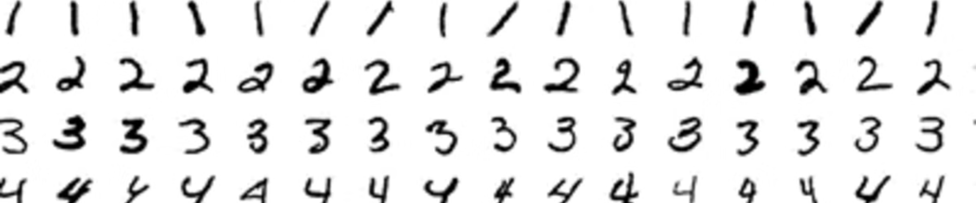
Dataset Preparation and Preprocessing
1
Data Collection
2
Data Preprocessing
3
Data Augmentation
Acquire a large and diverse dataset of handwritten digit images, such as the MNIST dataset, which contains 60,000 training and 10,000 test images.
Preprocess the images by normalizing pixel values, resizing, and converting to grayscale to ensure consistent input for the CNN model.
Apply data augmentation techniques, such as rotation, translation, and scaling, to increase the size and diversity of the training dataset.

Slide 5

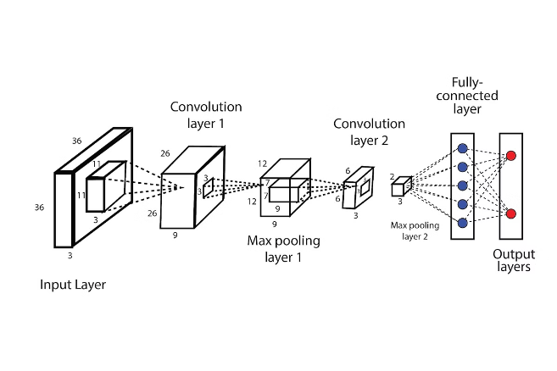
Convolutional Layer Architecture
1
Convolution
The convolutional layer applies a set of learnable filters to the input image, extracting relevant features and creating feature maps.
2
Activation
The feature maps are then passed through a non-linear activation function, such as ReLU, to introduce non-linearity and enhance the learning capabilities of the model.
3
Pooling
The pooling layer reduces the spatial dimensions of the feature maps, helping to make the model more robust and efficient.

Slide 6
Pooling and Activation Functions
Pooling
Activation Functions
Efficiency
Common pooling operations include max pooling and average pooling, which help to extract the most important features and reduce the number of parameters in the model.
Activation functions, such as ReLU, Sigmoid, and Tanh, introduce non-linearity and help the model learn complex patterns in the data.
By combining convolutional layers, pooling layers, and activation functions, CNNs can efficiently process and classify handwritten digit images.

Slide 7

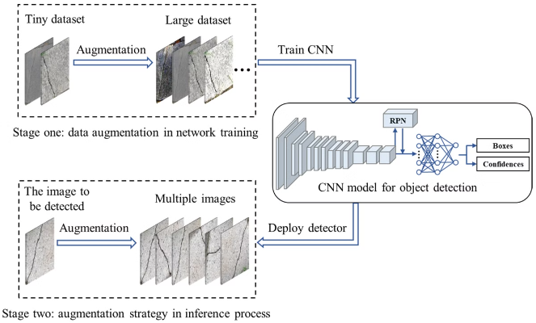
Training and Optimization Techniques
Optimization
Use optimization algorithms like Stochastic Gradient Descent (SGD) or Adam to update the model's weights and biases during the training process.
Regularization
Apply regularization techniques, such as L1/L2 regularization or dropout, to prevent overfitting and improve the model's generalization performance.
Batch Normalization
Implement batch normalization to stabilize the training process and improve the model's convergence speed.
Early Stopping
Monitor the model's performance on a validation set and stop the training process when the validation accuracy stops improving.

Slide 8


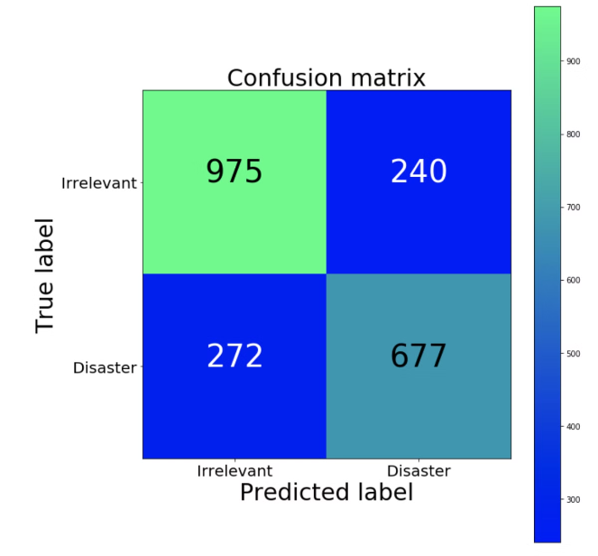



Model Evaluation and Performance Metrics
Accuracy
The percentage of correctly classified digit images, a key metric for evaluating the model's overall performance.
Precision
The ratio of true positive predictions to the total number of positive predictions, measuring the model's ability to avoid false positives.
Recall
The ratio of true positive predictions to the total number of actual positive instances, measuring the model's ability to identify all positive cases.
F1-Score
The harmonic mean of precision and recall, providing a balanced measure of the model's overall performance.

Slide 9




Deployment and Real-World Applications
Mobile Apps
Automated Data Entry
Security Systems
Digit recognition models can be deployed in mobile applications for tasks such as mobile check deposit, form filling, and document scanning.
Digit recognition can be used to automate data entry processes in industries like banking, insurance, and logistics, improving efficiency and reducing errors.
Digit recognition can be integrated into security systems for identity verification, access control, and fraud detection applications.

Slide 10

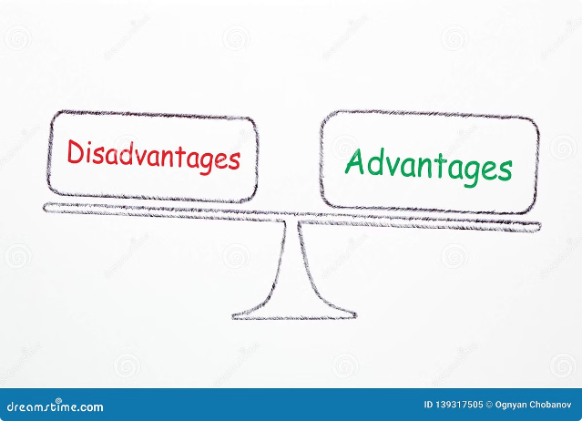
Advantages and Disadvantages
Advantages
Disadvantages
High accuracy for digit recognition
Requires a large amount of training data
Ability to handle complex and diverse input data
Computationally intensive and may require specialized hardware
Scalable and can be deployed in a variety of applications
Limited interpretability of the model's decision-making process

Slide 11

Thank You
We hope this presentation has provided a comprehensive overview of digit recognition using convolutional neural networks and their real-world applications.

